Slide 1



Spotify Data Engineering and Analytics Pipeline
Presented By:
Vaishnavi Chinnala
Mentor :
Vinay Sattu

Slide 2
Table of Contents :
Problem Statement
Research
Resource Requirements
Solution approach
Architecture
Flow Chart
Services and Tools
Implementation
Results
Power BI Visuals
Conclusion
Future scope
References

Slide 3
Problem Statement
Spotify has a vast collection of music data across various regions, languages, and user preferences. To derive meaningful insights from this massive dataset, I aimed to create an end- to-end automated data pipeline that can extract, enrich, transform, and load this data into a scalable data warehouse. The end goal is to enable data analysts and business users to gain valuable insights using interactive Power BI dashboards.

Slide 4
Research
Spotify APIs: Studied the Spotify Web API for endpoints related to track, album, artist, and audio features.
Data Formats: JSON format for Spotify API responses, converted to CSV for Snowflake
compatibility.
Data Enrichment: Integrated language detection (LangDetect) and simulated streaming
data for richer analysis.
Data Pipeline Design: Compared multiple orchestration tools like Azure Data Factory and
Airflow. Selected Apache Airflow for its scalability and integration capabilities.
Warehousing Strategy: Chose Snowflake for its columnar storage, scalability, and
support for semi-structured data.
BI Tools: Evaluated Tableau and Power BI; chose Power BI due to its native integration with Snowflake ecosystem and ease of use.

Slide 5
Resource Requirement and Specifications
Datasets:
The Spotify API data is fetched from Spotify for developers:
Home | Spotify for Developers
The CSV file is taken from the mentioned Kaggle link
Spotify User Behavior Dataset
Requirements:
Azure Portal (Blob Storage)
Snowflake
Power BI
Apache Airflow
Python, Pandas, Requests, LangDetect

Slide 6
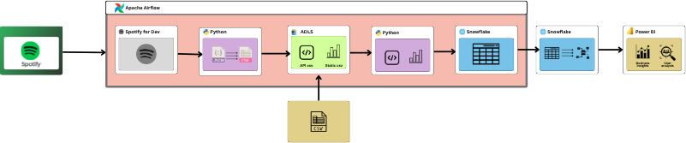
Architecture Diagram

Slide 7
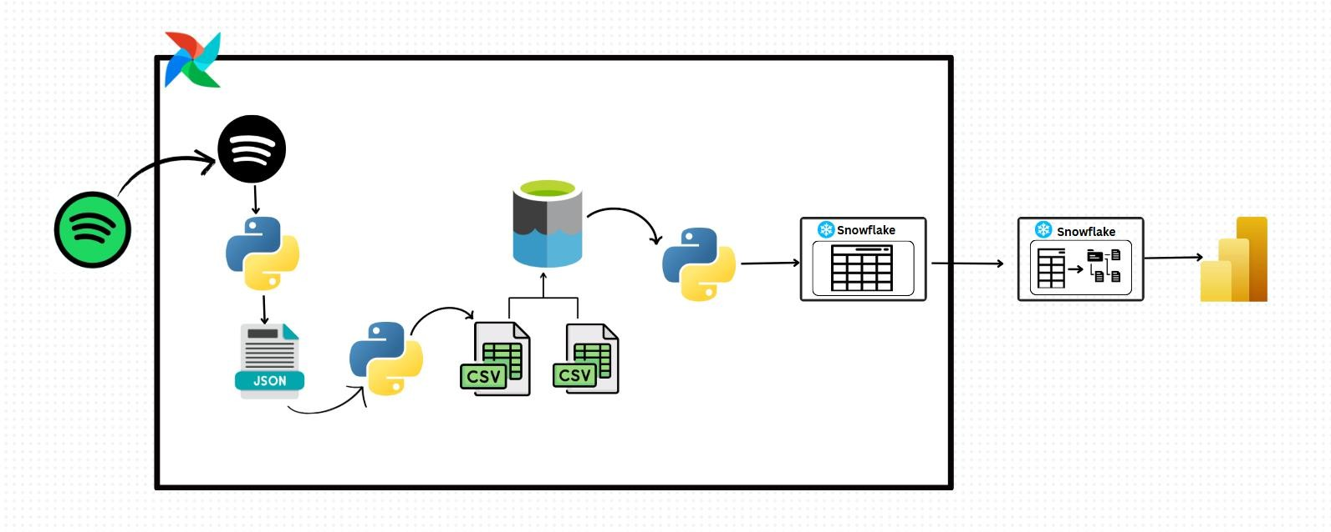
Flow Diagram

Slide 8
Services and Tools to be Used
Spotify for Developers API
Python
Apache Airflow
DAG creation
Task scheduling
PythonOperator usage
Workflow orchestration
Data pipeline automation
Azure Data Lake Storage Gen2 (ADLS)
Snowflake
Power BI

Slide 9
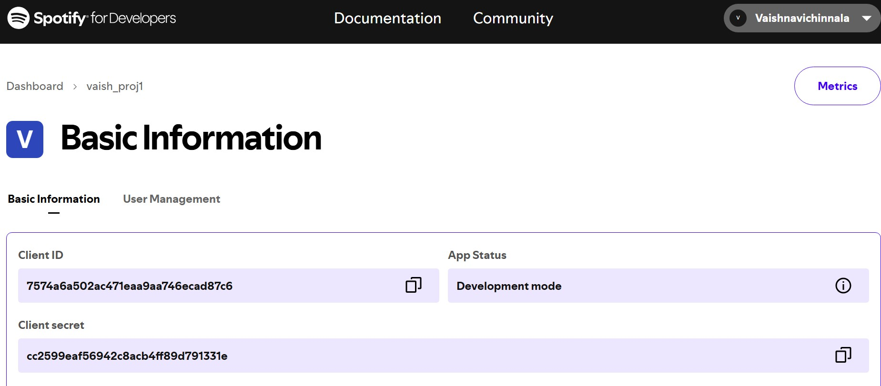
Implementation(contd…)
Spotify Developer Dashboard showing Client ID and Secret used for authenticated API access in the vaish_proj1 application.

Slide 10
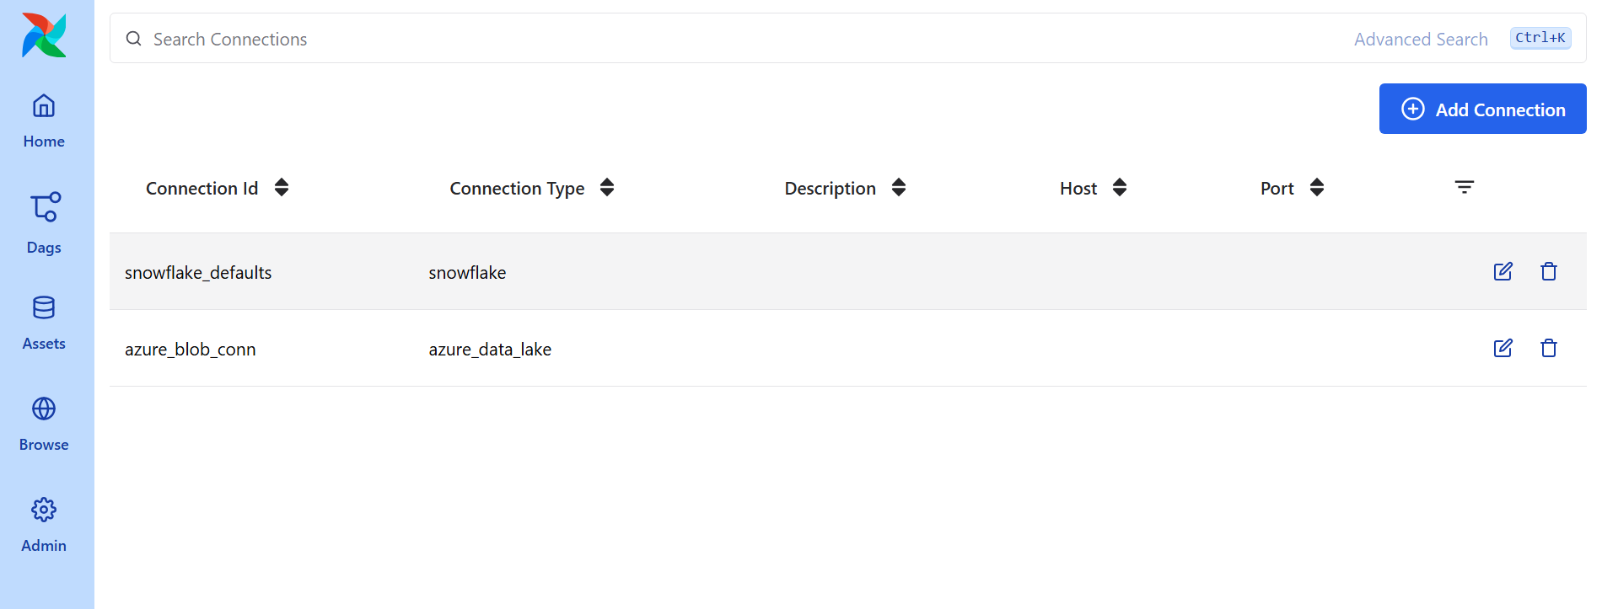
Implementation
Airflow UI displaying established connections for Snowflake and Azure Data Lake, enabling seamless data
pipeline integration.

Slide 11
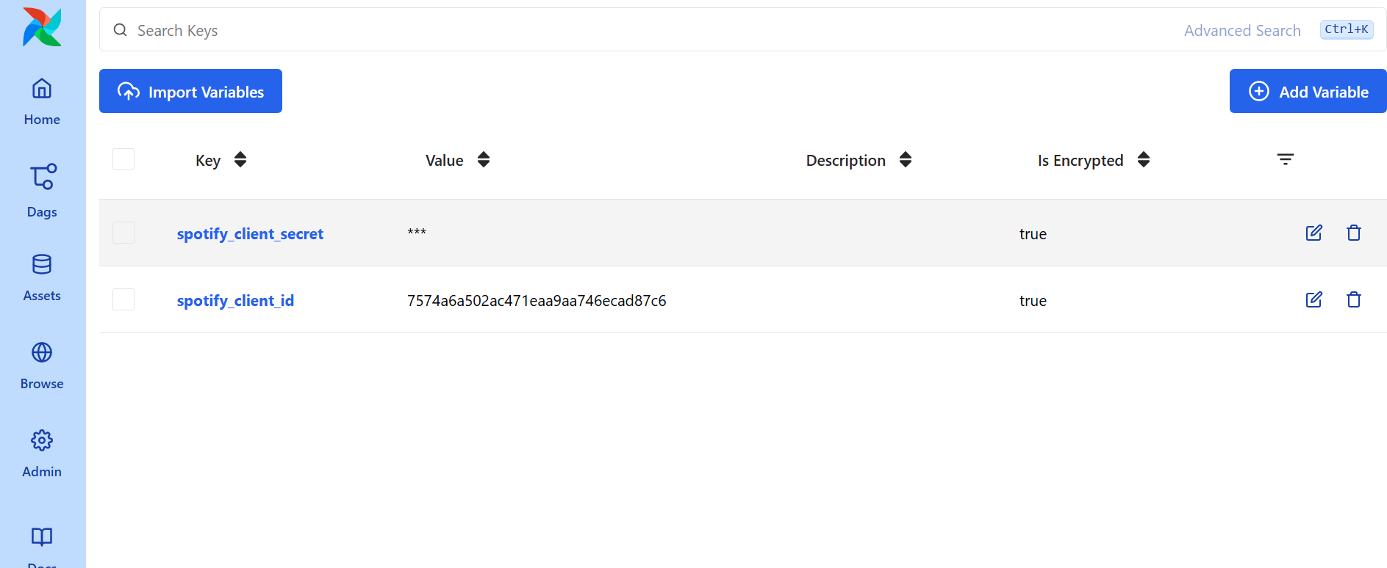
Implementation
Airflow UI showcasing securely stored Spotify API credentials (client_id and client_secret) as encrypted variables for use in DAGs.

Slide 12
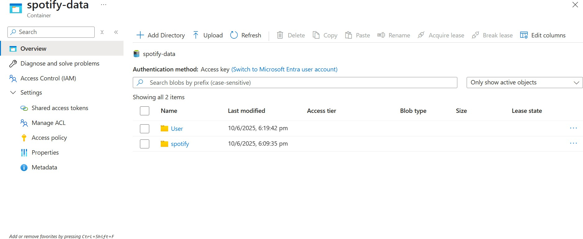
Implementation
Azure Blob Storage container spotify-data displaying two folders (User and spotify) storing data blobs uploaded during the Spotify data pipeline execution.

Slide 13
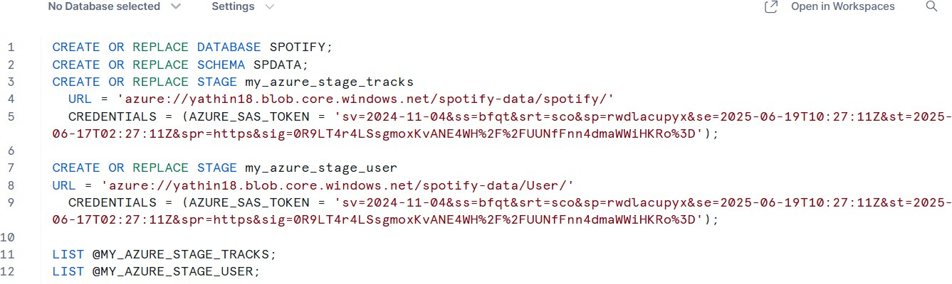
Implementation
Snowflake SQL script creating database SPOTIFY, schema SPDATA, and external stages (my_azure_stage_tracks and my_azure_stage_user) using SAS tokens to access Azure Blob Storage folders (spotify and User).

Slide 14
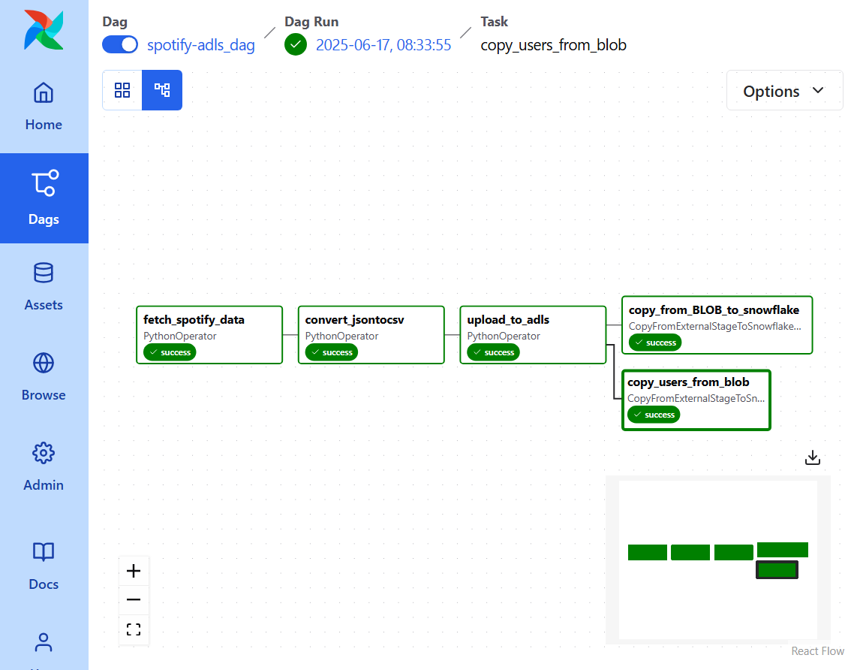
Implementation
The successful execution of the spotify-adls_dag in Apache Airflow, which automates the
data pipeline from Spotify API extraction to Snowflake loading.

Slide 15
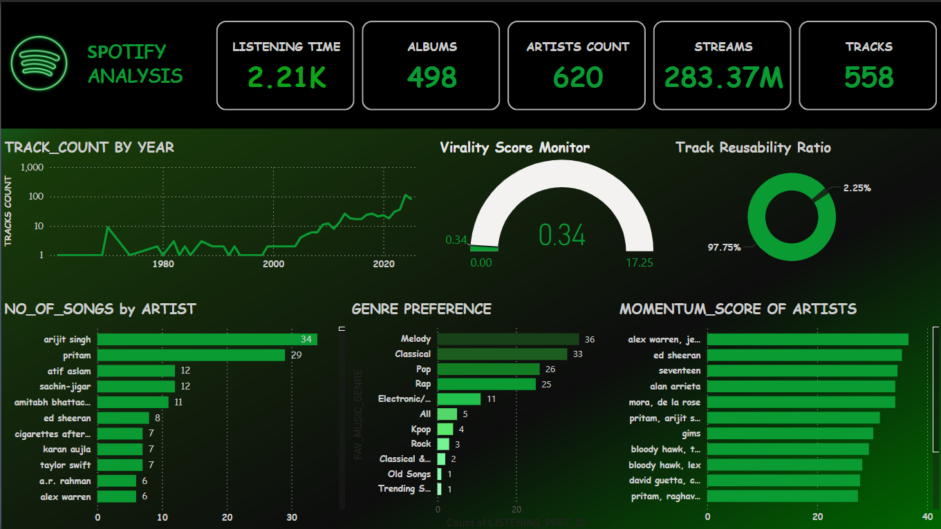
Power BI Visuals

Slide 16
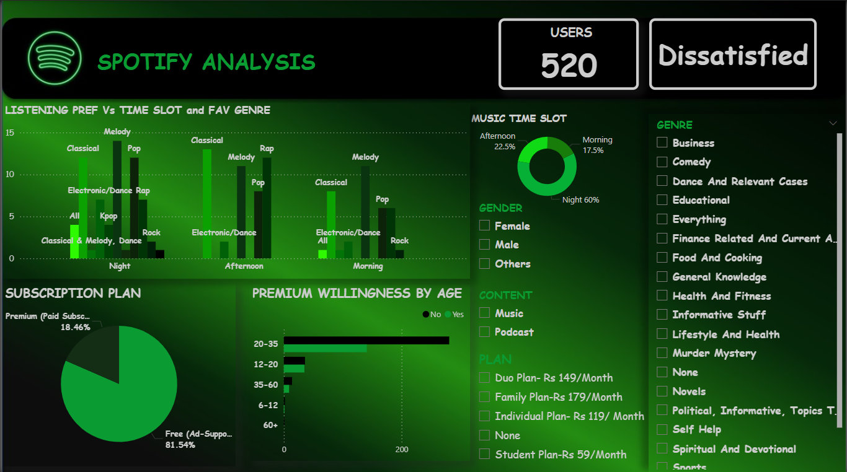
Power Bi Visuals

Slide 17
Conclusion
This Spotify Data Engineering project showcases the end-to-end development of a modern data pipeline by integrating the Spotify API with Azure and Snowflake. Using Python scripts, track and user-related data are extracted, transformed into structured CSV files, and stored in Azure Blob Storage. External stages in Snowflake are created using secure SAS tokens to access this data, and Airflow orchestrates the automated loading process into Snowflake tables. SQL views are then built on top of the loaded data to enable efficient querying and analytics. Finally, Power BI is used to design interactive dashboards, offering real-time insights into music trends, track performance, and user behavior.

Slide 18
Future Scope
Voice and IoT Device Integration: Extend the pipeline to include data from smart speakers and IoT devices to better understand contextual listening habits and enhance cross-platform experiences.
Sentiment Analysis on User Feedback: Use NLP techniques to analyze user reviews, comments, or playlist names to extract sentiment trends and improve recommendation logic.
Dynamic Pricing Strategies for Premium Plans: Analyze user behavior patterns to recommend optimal pricing models or discounts, increasing premium subscription conversions.

Slide 19
References
Spotify API Documentation
Azure Data Factory Docs
Snowflake Documentation
Power BI
LangDetect Library
Airflow Docs

Slide 20





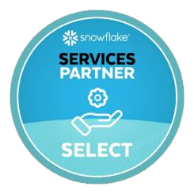






www.anblicks.com
Vaishnavi.chinnala@anblicks.com
Technology Partnerships
© Anblicks. All Rights Reserved
20

